Slide 1
OOPS 2
WRAPPER CLASSES AND INHERITANCE
LECTURE 4

Slide 2
WRAPPER CLASSES
The wrapper class in Java provides the mechanism to convert primitive into object and object into primitive.
Auto boxing and Unboxing feature convert primitives into objects and objects into primitives automatically.
The automatic conversion of primitive into an object is known as auto boxing and vice-versa unboxing.

Slide 3
NEED OF WRAPPER CLASSES
Change the value in Method:
Java supports only call by value.
So, if we pass a primitive value, it will not change the original value.
But, if we convert the primitive value in an object, it will change the original value.

Slide 4
Serialization:
We need to convert the objects into streams to perform the serialization.
If we have a primitive value, we can convert it in objects through the wrapper classes.

Slide 5
Synchronization:
Java synchronization works with objects in Multithreading.
java.util package:
The java.util package provides the utility classes to deal with objects.

Slide 6
Collection Framework:
Java collection framework works with objects only.
All classes of the collection framework
ArrayList, LinkedList, Vector, HashSet, LinkedHashSet etc.
Deal with objects only.

Slide 7
TABLE LIST USED BY JAVA COMPILER FOR AUTOBOXING AND UNBOXING
Primitive type
boolean
byte
char
float
int
long
short
double
Wrapper Classes
Boolean
Byte
Character
Float
Integer
Long
Short
Double

Slide 8
ACTIVITY-1
class BoxingExample1{
public static void main(String args[]){
int a=50;
Integer a2=new Integer(a);//Boxing.
Integer a3=5;//Boxing.
System.out.println(a2+" "+a3);
}
}

Slide 9
OUTPUT:
50 5
Source :
http://javajee.com/wrapper-classes-auto-boxing-and-auto-unboxing

Slide 10
ACTIVITY-2
class UnboxingExample1{
public static void main(String args[])
{
Integer i=new Integer(50);
int a=i;
System.out.println(a);
}
}

Slide 11
OUTPUT
50

Slide 12
INTEGER CLASS
parseInt:
parseInt(String s) − This returns an integer (decimal only).
parseInt(int i) − This returns an integer, given a string representation of decimal, binary,
octal, or hexadecimal (radix equals 10, 2, 8, or 16 respectively) numbers as input.

Slide 13
ACTIVITY-3
int x =Integer. parseInt("9");
double c = Double.parseDouble("5");
System.out.println(x);
System.out.println(c);

Slide 14
OUTPUT:
9
5.0

Slide 15
MAXVALUE:
Integer.MAX_VALUE is a constant in the Integer class of java.lang package
that specifies that stores the maximum possible value for any integer variable in Java.

Slide 16
MINVALUE:
Integer.MIN_VALUE is a constant in the Integer class of java.lang package
that specifies that stores the minimum possible value for any integer variable in Java.

Slide 17
ACTIVITY-4
int a = Integer.MAX_VALUE;
System.out.println("max value "+a);
int b = Integer.MIN_VALUE;
System.out.println("min value "+b);

Slide 18
Output:
max value 2147483647
min value -2147483648

Slide 19
NUMBERFORMATEXCEPTION
Constructor | Description
NumberFormatException() | This constructs a NumberFormatException with no specified detailed message.
NumberFormatException(String s) | This constructs a NumberFormatException with a detailed specified message in string s.

Slide 20
ACTIVITY-5
public class Example {
public static void main(String[] args) {
int a = Integer.parseInt(null); //throws Exception as //the input string is of illegal format for parsing as it is null.
}
}

Slide 21
IMPORTANT EXAMPLES
The input string provided might be null-
Example- Integer.parseInt(null);
The input string might be empty-
Example- Integer.parseInt("");
The input string might be having trailing space
- Example- Integer.parseInt("123 ");

Slide 22
The input string might be having a leading space-
Example- Integer.parseInt(" 123");
The input string may be alphanumeric
- Example- Long.parseLong("b2");

Slide 23
The input string may have an input that might exceed the range of the datatype
storing the parsed string-
Example- Integer.parseInt("135"); The maximum possible value of integer can be 127
but the value in the string is 135 which is out of range, so this will throw the exception.
Range will be 127 to -128=1 byte

Slide 24
String.valueOf
The java string.valueOf() method converts different types of values into string.
By the help of string.valueOf() method, you can convert into string,
long to string, boolean to string,
character to string, float to string,
double to string, object to string
and char array to string.

Slide 25
ACTIVITY-7
boolean b = true;
long l = 1232874;
char[] arr = {'a', 'b', 'c', 'd', 'e', 'f','g' };
System.out.println("Return Value : " + String.valueOf(b) );
System.out.println("Return Value : " + String.valueOf(l) );
System.out.println("Return Value : " + String.valueOf(arr) );

Slide 26
OUTPUT:
Return Value : true
Return Value : 1232874
Return Value : abcdefg

Slide 27
CHARACTER CLASSES COMMONLY USED METHOD
METHODS
MMLAHC
ETHODSMETHODS
isLetter()
isDigit()
isWhitespace()
isUpperCase()
isLowerCase()
DESCRIPTION
mines whether the
Determines whether the specified char value is a letter.
specified char value is a letter.
Determines whether the specified char value is a digit.
Determines whether the specified char value is whitespace.
Determines the specified char value is uppercase.
Determines whether the specified charvalue is lowercase.

Slide 28
METHODS
toUpperCase()
()
toLowerCase()
toString()
DESCRIPTION
RReturns the uppercase form of the specified char value.eturns the uppercase form of t
specified char value.
Returns the lowercase form of the specified char value.
Returns a String object representing the specified character value i.e. one character string.

Slide 29
WHAT IS INHERITANCE
It is a mechanism where a new class is derived from an existing class.
Classes may inherit or acquire the properties and methods of other classes.
A class is derived from another class is called a subclass.
A class from which a subclass is derived is called a superclass.

Slide 30
NEED OF INHERITANCE
Application development time is less.
Application take less memory.
Application execution time is less.
Application performance is enhance (improved).
Redundancy (repetition) of the code is reduced or minimized so that we get consistence results and less storage cost.

Slide 31
TYPES OF INHERITANCE
SINGLE INHERITANCE:
One class is extended by only one class.

Slide 32
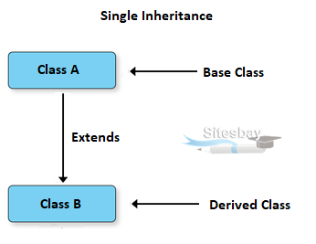
FLOW DIAGRAM

Slide 33
MULTILEVEL INHERITANCE
One class is extended by a second class
which in turn inherits from the third class
and so on thus forming a chain of inheritance

Slide 34
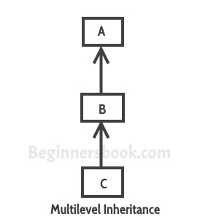
FLOW DIAGRAM

Slide 35
HIERARCHICAL INHERITANCE
One class is extended by many classes.

Slide 36
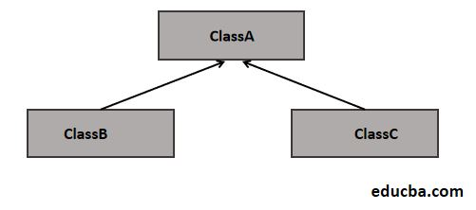
FLOW DIAGRAM

Slide 37
HYBRID INHERITANCE
Combination of hierarchical and single inheritance.

Slide 38
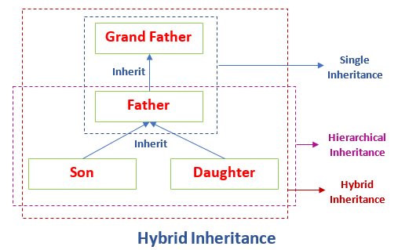
FLOW DIAGRAM

Slide 39
MULTIPLE INHERITANCE
One class extends or inherits from more than one class.
It is not supported by Java.

Slide 40
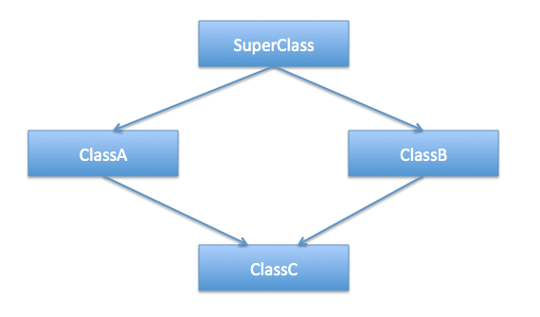
FLOW DIAGRAM

Slide 41
EXAMPLE OF INHERITANCE
Data members and methods are represented in broken line
are inherited from faculty class and they are visible in student class logically.

Slide 42
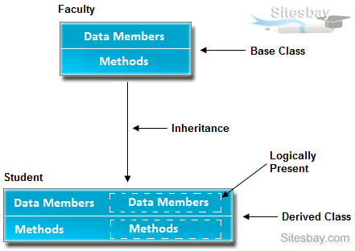

Slide 43
WHY NO MULTIPLE INHERITANCE IN JAVA?

Slide 44
DIAMOND PROBLEM
Class C extends from both the classes B and A.
Classes B and A in turn extend from superclass.
Let’s assume there is a method defined in superclass and Class B and A are overriding this method.
Here lies the problem.
Since Class C is extending from multiple classes B and A the same method will be inherited from both of them.
So, if class C have to decided which method to use i.e. overriden from class B and A.
This creates ambiguity.

Slide 45
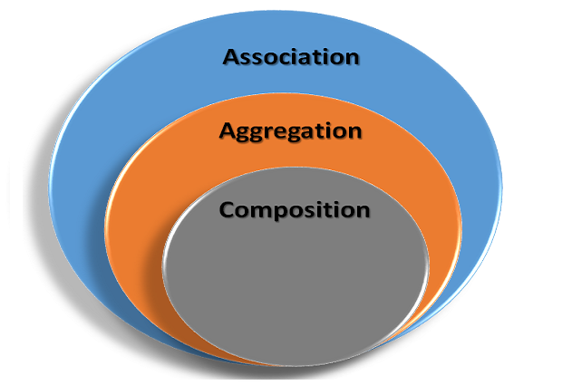
SOME OF THE IMPORTANT TERMS

Slide 46
Association is a relation between two separate classes which establishes through their Objects.
Association can be one-to-one, one-to-many, many-to-one, many-to-many.
In Object-Oriented programming, an Object communicates to another object to use
functionality and services provided by that object.
Composition and Aggregation are the two forms of association.

Slide 47
VIDEO LINK
Association ,Aggregation and Composition
https://youtu.be/zLvOO4pm6ZI
Difference between inheritance and composition.
https://youtu.be/3eo2Hqz2t9c

Slide 48
INTERVIEW QUESTIONS
What is Inheritance in Java?
Ans: The technique of creating a new class by using an existing class functionality is called inheritance in Java. In other words, inheritance is a process where a child class acquires all the properties and behaviors of the parent class.
2. Why do we need to use inheritance? Or, What is the purpose of using inheritance?
Ans: Inheritance is one of the main pillars of OOPs concept. Some objects share certain properties and behaviors. By using inheritance, a child class acquires all properties and behaviors of parent class.
There are the following reasons to use inheritance in java.
We can reuse the code from the base class.
Using inheritance, we can increase features of class or method by overriding.
Inheritance is used to use the existing features of class.
It is used to achieve runtime polymorphism i.e method overriding.
3. What is Is-A relationship in Java?
Ans: Is-A relationship represents Inheritance. It is implemented using the “extends” keyword. It is used for code reusability.
4. What is super class and subclass?
Ans: A class from where a subclass inherits features is called superclass. It is also called base class or parent class.
A class that inherits all the members (fields, method, and nested classes) from other class is called subclass. It is also called a derived class, child class, or extended class.
5. How is Inheritance implemented/achieved in Java?
Ans: Inheritance can be implemented or achieved by using two keywords:
extends: extends is a keyword that is used for developing the inheritance between two classes and two interfaces.
implements: implements keyword is used for developing the inheritance between a class and interface.
6. Write the syntax for creating the subclass of a class?
Ans: A subclass can be created by using the “extends” keyword. The syntax for declaring a subclass of class is as follows:
class subclassName extends superclassName { // Variables of subclass // Methods of subclass }
where class and extends are two keywords.
7. Which class in Java is superclass of every other class?
Ans: In Java, Object class is the superclass of every other class.
8. How will you prove that the features of Superclass are inherited in Subclass?
Ans: Refer to this tutorial: Inheritance in Java with Realtime Example
9. Can a class extend itself?
Ans: No, a class cannot extend itself.
10. Can we assign superclass to subclass?
Ans: No.
11. Can a class extend more than one class?
Ans: No, one class can extend only a single class.
12. Are constructor and instance initialization block inherited to subclass?
Ans: No, constructor and instance initialization block of the superclass cannot be inherited to its subclass but they are executed while creating an object of the subclass.
13. Are static members inherited to subclass in Java?
Ans: Static block cannot be inherited to its subclass.
A static method of superclass is inherited to the subclass as a static member and non-static method is inherited as a non-static member only.
14. Can we extend (inherit) final class?
Ans: No, a class declared with final keyword cannot be inherited.
15. Can a final method be overridden?
Ans: No, a final method cannot be overridden.
16. Can we inherit private members of base class to its subclass?
Ans: No.
17. What is order of calling constructors in case of inheritance?
Ans: In case of inheritance, constructors are called from the top to down hierarchy.
18. Which keyword do you use to define a subclass? Or, which keyword is used to inherit a class?
Ans: extends keyword.
19. What are the advantages of inheritance in Java?
Ans: The advantages of inheritance in java are as follows:
We can minimize the length of duplicate code in an application by putting the common code in the superclass and sharing it amongst several subclasses.
Due to reducing the length of code, the redundancy of the application is also reduced.
Inheritance can also make application code more flexible to change.
20. What are the types of inheritance in Java?
Ans: The various types of inheritance are as follows:
a. Single inheritance b. Multi-level inheritance c. Hierarchical inheritance d. Multiple inheritance e. Hybrid inheritance
21. What are the various forms of inheritance available in Java?
Ans: The various forms of inheritance to use are single inheritance, hierarchical inheritance, and multilevel inheritance.
22. What is single inheritance and multi-level inheritance?
Ans: When one class is extended by only one class, it is called single level inheritance. In single-level inheritance, we have just one base class and one derived class.
A class which is extended by a class and that class is extended by another class forming chain inheritance is called multilevel inheritance.
23. What is Multiple inheritance in Java?
Ans: A class that has many superclasses is known as multiple inheritance. In other words, when a class extends multiple classes, it is known as multiple inheritance.
24. Why multiple inheritance is not supported in java through class? Ans:
Multiple inheritance means that one class extends two superclasses or base classes but in Java, one class cannot extend more than one class simultaneously. At most, one class can extend only one class.
Therefore, to reduce ambiguity, complexity, and confusion, Java does not support multiple inheritance through classes.
For more detail, go to this tutorial: Types of Inheritance in Java
25. How does Multiple inheritance implement in Java?
Ans: Multiple inheritance can be implemented in Java by using interfaces. A class cannot extend more than one class but a class can implement more than one interface.
26. What is Hybrid inheritance in java? How will you achieve it?
Ans: A hybrid inheritance in java is a combination of single and multiple inheritance. It can be achieved through interfaces.
27. How will you restrict a member of a class from inheriting its subclass?
Ans: We can restrict members of a class by declaring them private because the private members of superclass are not available to the subclass directly. They are only available in their own class.
28. Can we access subclass members if we create an object of superclass?
Ans: No, we can access only superclass members but not the subclass members.
29. Can we access both superclass and subclass members if we create an object of subclass?
Ans: Yes, we can access both superclass and subclass members.
30. What happens if both superclass and subclass have a field with the same name?
Ans: Only subclass members are accessible if an object of subclass is instantiated.
31. Will the code successfully compiled? If yes, what is the output?
public class A { int x = 20; } public class B extends A { int x = 30; } public class Test { public static void main(String[] args) { B b = new B(); System.out.println(b.x); A a = new A(); System.out.println(a.x); A a2 = new B(); System.out.println(a2.x); } }
Ans: Yes, code will be successfully compiled. The output is 30, 20, 20.
32. Which of the following is correct way of inheriting class A by class B?
a) class B + class A { } b) class B inherits class A { } c) class B extends A { } d) class B extends class A { }
Ans: c
33. Is interface inherited from the Object class?
Ans: No.
34. What is the output of executing code of class Test?
public class A { void m1() { System.out.println("m1 in class A"); } } public class B extends A { void m1() { System.out.println("m1 in class B"); } } public class Test { public static void main(String[] args) { B b = new B(); b.m1(); A a = new A(); a.m1(); A a2 = new B(); a2.m1(); } }
Ans: The result is m1 in class B, m1 in class A, m1 in class B.
34. Will this code run successfully? If yes, what will be the output?
public class A { private int x = 50; void m1() { System.out.println(x); } } public class B extends A { } public class Test { public static void main(String[] args) { A a = new B(); a.m1(); } }
Ans: Yes, code will be successfully compiled. The output will be 50.
35. Will this code compile successfully? If yes, what is the output? If no, identify the errors.
package pack1; public class A { private int x = 50; protected int y = 100; int z = 200; } package pack2; import pack1.A; public class B extends A { } import pack2.B; public class Test { public static void main(String[] args) { B b = new B(); System.out.println(b.x); System.out.println(b.y); System.out.println(b.z); } }
Ans: No, the code will not compile successfully because of two compile-time errors.
First error is in line System.out.println(b.x); because private members cannot be accessed in the subclass.
Second error is in line System.out.println(b.y); because default members of superclass can be accessed in the subclass within the same package only.
Pages: 1 2 3
CategoriesCore Java, InterviewTagsJava Inheritance Interview Questions and Answers, Programming Exercises on Inheritance in Java
What is Inheritance in Java?
Ans: The technique of creating a new class by using an existing class functionality is called inheritance in Java. In other words, inheritance is a process where a child class acquires all the properties and behaviors of the parent class.
2. Why do we need to use inheritance? Or, What is the purpose of using inheritance?
Ans: Inheritance is one of the main pillars of OOPs concept. Some objects share certain properties and behaviors. By using inheritance, a child class acquires all properties and behaviors of parent class.
There are the following reasons to use inheritance in java.
We can reuse the code from the base class.
Using inheritance, we can increase features of class or method by overriding.
Inheritance is used to use the existing features of class.
It is used to achieve runtime polymorphism i.e method overriding.
3. What is Is-A relationship in Java?
Ans: Is-A relationship represents Inheritance. It is implemented using the “extends” keyword. It is used for code reusability.
4. What is super class and subclass?
Ans: A class from where a subclass inherits features is called superclass. It is also called base class or parent class.
A class that inherits all the members (fields, method, and nested classes) from other class is called subclass. It is also called a derived class, child class, or extended class.
5. How is Inheritance implemented/achieved in Java?
Ans: Inheritance can be implemented or achieved by using two keywords:
extends: extends is a keyword that is used for developing the inheritance between two classes and two interfaces.
implements: implements keyword is used for developing the inheritance between a class and interface.
6. Write the syntax for creating the subclass of a class?
Ans: A subclass can be created by using the “extends” keyword. The syntax for declaring a subclass of class is as follows:
class subclassName extends superclassName { // Variables of subclass // Methods of subclass }
where class and extends are two keywords.
7. Which class in Java is superclass of every other class?
Ans: In Java, Object class is the superclass of every other class.
8. How will you prove that the features of Superclass are inherited in Subclass?
Ans: Refer to this tutorial: Inheritance in Java with Realtime Example
9. Can a class extend itself?
Ans: No, a class cannot extend itself.
10. Can we assign superclass to subclass?
Ans: No.
11. Can a class extend more than one class?
Ans: No, one class can extend only a single class.
12. Are constructor and instance initialization block inherited to subclass?
Ans: No, constructor and instance initialization block of the superclass cannot be inherited to its subclass but they are executed while creating an object of the subclass.
13. Are static members inherited to subclass in Java?
Ans: Static block cannot be inherited to its subclass.
A static method of superclass is inherited to the subclass as a static member and non-static method is inherited as a non-static member only.
14. Can we extend (inherit) final class?
Ans: No, a class declared with final keyword cannot be inherited.
15. Can a final method be overridden?
Ans: No, a final method cannot be overridden.
16. Can we inherit private members of base class to its subclass?
Ans: No.
17. What is order of calling constructors in case of inheritance?
Ans: In case of inheritance, constructors are called from the top to down hierarchy.
18. Which keyword do you use to define a subclass? Or, which keyword is used to inherit a class?
Ans: extends keyword.
19. What are the advantages of inheritance in Java?
Ans: The advantages of inheritance in java are as follows:
We can minimize the length of duplicate code in an application by putting the common code in the superclass and sharing it amongst several subclasses.
Due to reducing the length of code, the redundancy of the application is also reduced.
Inheritance can also make application code more flexible to change.
20. What are the types of inheritance in Java?
Ans: The various types of inheritance are as follows:
a. Single inheritance b. Multi-level inheritance c. Hierarchical inheritance d. Multiple inheritance e. Hybrid inheritance
21. What are the various forms of inheritance available in Java?
Ans: The various forms of inheritance to use are single inheritance, hierarchical inheritance, and multilevel inheritance.
22. What is single inheritance and multi-level inheritance?
Ans: When one class is extended by only one class, it is called single level inheritance. In single-level inheritance, we have just one base class and one derived class.
A class which is extended by a class and that class is extended by another class forming chain inheritance is called multilevel inheritance.
23. What is Multiple inheritance in Java?
Ans: A class that has many superclasses is known as multiple inheritance. In other words, when a class extends multiple classes, it is known as multiple inheritance.
24. Why multiple inheritance is not supported in java through class? Ans:
Multiple inheritance means that one class extends two superclasses or base classes but in Java, one class cannot extend more than one class simultaneously. At most, one class can extend only one class.
Therefore, to reduce ambiguity, complexity, and confusion, Java does not support multiple inheritance through classes.
For more detail, go to this tutorial: Types of Inheritance in Java
25. How does Multiple inheritance implement in Java?
Ans: Multiple inheritance can be implemented in Java by using interfaces. A class cannot extend more than one class but a class can implement more than one interface.
26. What is Hybrid inheritance in java? How will you achieve it?
Ans: A hybrid inheritance in java is a combination of single and multiple inheritance. It can be achieved through interfaces.
27. How will you restrict a member of a class from inheriting its subclass?
Ans: We can restrict members of a class by declaring them private because the private members of superclass are not available to the subclass directly. They are only available in their own class.
28. Can we access subclass members if we create an object of superclass?
Ans: No, we can access only superclass members but not the subclass members.
29. Can we access both superclass and subclass members if we create an object of subclass?
Ans: Yes, we can access both superclass and subclass members.
30. What happens if both superclass and subclass have a field with the same name?
Ans: Only subclass members are accessible if an object of subclass is instantiated.
31. Will the code successfully compiled? If yes, what is the output?
public class A { int x = 20; } public class B extends A { int x = 30; } public class Test { public static void main(String[] args) { B b = new B(); System.out.println(b.x); A a = new A(); System.out.println(a.x); A a2 = new B(); System.out.println(a2.x); } }
Ans: Yes, code will be successfully compiled. The output is 30, 20, 20.
32. Which of the following is correct way of inheriting class A by class B?
a) class B + class A { } b) class B inherits class A { } c) class B extends A { } d) class B extends class A { }
Ans: c
33. Is interface inherited from the Object class?
Ans: No.
34. What is the output of executing code of class Test?
public class A { void m1() { System.out.println("m1 in class A"); } } public class B extends A { void m1() { System.out.println("m1 in class B"); } } public class Test { public static void main(String[] args) { B b = new B(); b.m1(); A a = new A(); a.m1(); A a2 = new B(); a2.m1(); } }
Ans: The result is m1 in class B, m1 in class A, m1 in class B.
34. Will this code run successfully? If yes, what will be the output?
public class A { private int x = 50; void m1() { System.out.println(x); } } public class B extends A { } public class Test { public static void main(String[] args) { A a = new B(); a.m1(); } }
Ans: Yes, code will be successfully compiled. The output will be 50.
35. Will this code compile successfully? If yes, what is the output? If no, identify the errors.
package pack1; public class A { private int x = 50; protected int y = 100; int z = 200; } package pack2; import pack1.A; public class B extends A { } import pack2.B; public class Test { public static void main(String[] args) { B b = new B(); System.out.println(b.x); System.out.println(b.y); System.out.println(b.z); } }
Ans: No, the code will not compile successfully because of two compile-time errors.
First error is in line System.out.println(b.x); because private members cannot be accessed in the subclass.
Second error is in line System.out.println(b.y); because default members of superclass can be accessed in the subclass within the same package only.
Pages: 1 2 3
CategoriesCore Java, InterviewTagsJava Inheritance Interview Questions and Answers, Programming Exercises on Inheritance in Java
What is inheritance?
Refer slide
What are the types of inheritance?
Refer slide
How is Inheritance implemented/achieved in Java?
Ans: Inheritance can be implemented or achieved by using two keywords:
extends: extends is a keyword that is used for developing the inheritance between two classes and two interfaces.
implements: implements keyword is used for developing the inheritance between a class and interface.

Slide 49
Which class in Java is superclass of every other class?
Ans: In Java, Object class is the superclass of every other class.
Can a class extend itself?
Ans: No, a class cannot extend itself.
Can we assign superclass to subclass?
Ans: No.
Can a class extend more than one class?
Ans: No, one class can extend only a single class.

Slide 50
Can we access subclass members if we create an object of superclass?
Ans: No, we can access only superclass members but not the subclass members.
Can we access both superclass and subclass members if we create an object of subclass?
Ans: Yes, we can access both superclass and subclass members.
What happens if both superclass and subclass have a field with the same name?
Ans: Only subclass members are accessible if an object of subclass is instantiated.

Slide 51
THANKYOU

